Slide 1

Educational Loans Repayment
Miners Group

Slide 2
Project Name:
Educational Loans Repayment
Group:
Miners
Team Members:
Heba Saad Sayed
HebatAllah Zakaria
Usama Atteya
Yehia Atef Dorgham

Slide 3
Use Case & Problem Description
Most students during their college education incur significant amount of debt, their debt can vary from one college to the other also their repayment rates, many factors influence the debt and its repayment as well.
In an effort to make educational investments less speculative, the US Department of Education has matched information from the student financial aid system with federal tax returns to create the College Scorecard dataset.
Our objective is to use this dataset to predict students’ ability to repay their educational loans by exploring different institutional features.

Slide 4
Benefit for End users
The proposed predictive model will aid the decision makers of the US government to minimize the risk of bad debts.
Also it will put the power in the hands of students and families to compare colleges and see a better vision on how many graduates at a particular school are able to pay back their student loans.
The ability to pay back students loans is generally a good indicator of how well colleges and universities are preparing their graduates for the job market.

Slide 5
Data Sources
US Department of Education (https://collegescorecard.ed.gov/data/)
College Scorecard data are provided through federal reporting from institutions, data on federal financial aid, and tax information.
These data provide insights into the performance of schools that receive federal financial aid dollars, and the outcomes of the students of those schools.

Slide 6
Dataset Key Features
Feature | Description
GRAD_DEBT_MDN | The median debt for students who have completed
COMP_ORIG_YR4_RT | Percent completed within 4 years at original institution
PCTFLOAN | Percent of all federal undergraduate students receiving a federal student loan
md_earn_wne_p10 | Median earnings of students working and not enrolled 10 years after entry
INSTNM | Institution name
MEDIAN_HH_INC | Median household income
HIGHDEG | Highest degree awarded
CONTROL | identifies institution’s governance structure (public, private nonprofit, or private for-profit)
COSTT4_P | Average cost of attendance (program-year institutions)
COSTT4_A | Average cost of attendance (academic year institutions)
UGDS | Enrollment of undergraduate certificate/degree-seeking students

Slide 7
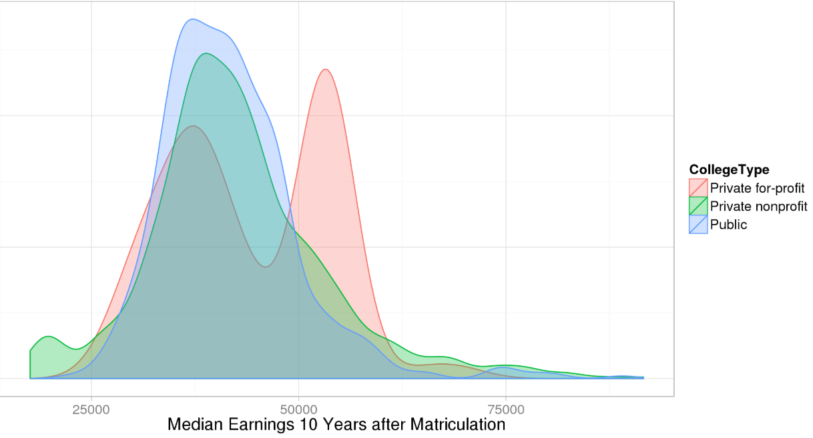
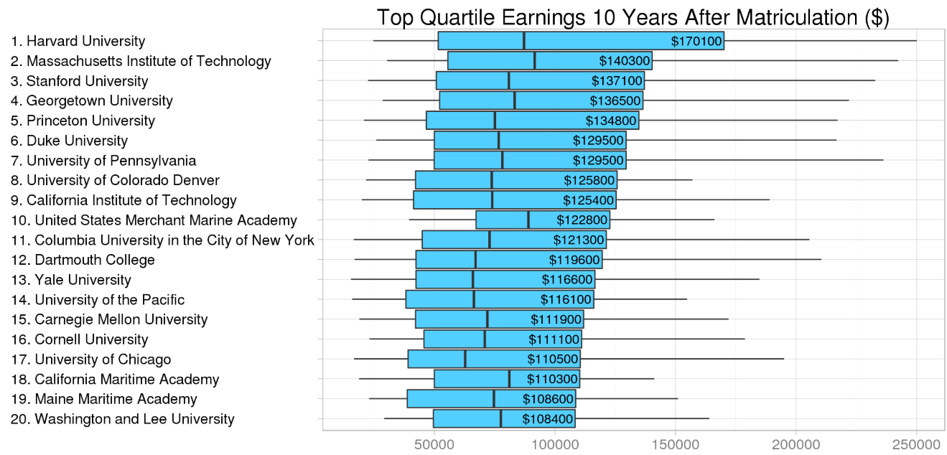
Statistical Analysis of the data

Slide 8
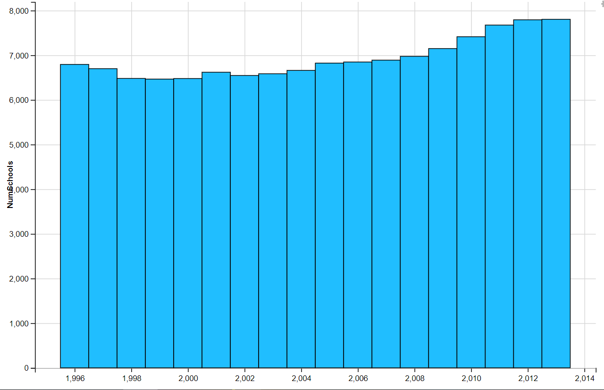
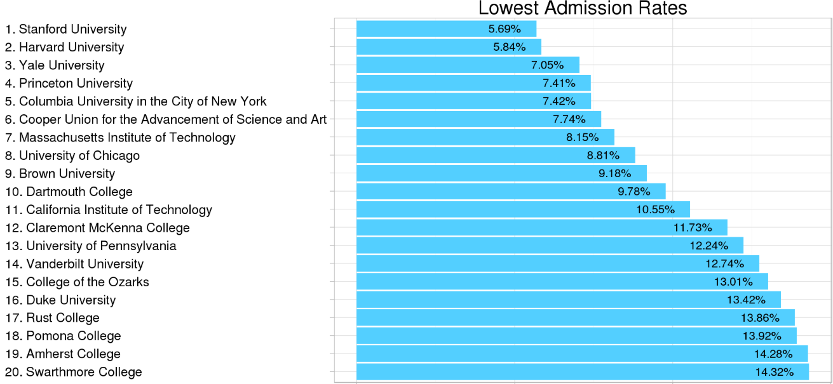
Statistical Analysis of the data

Slide 9
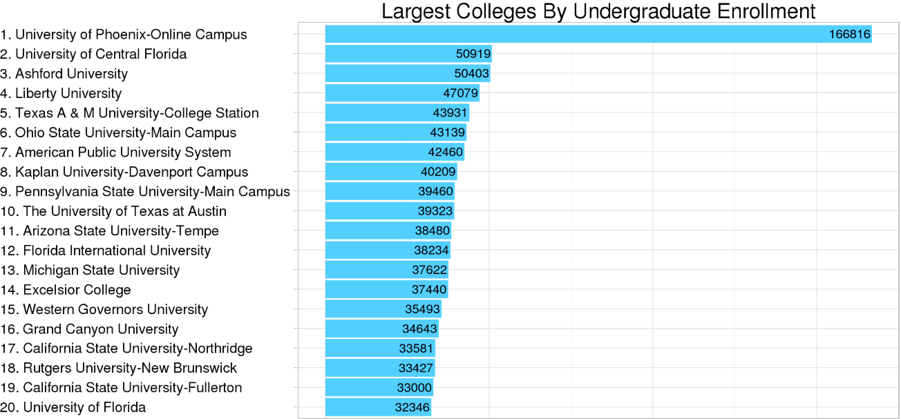
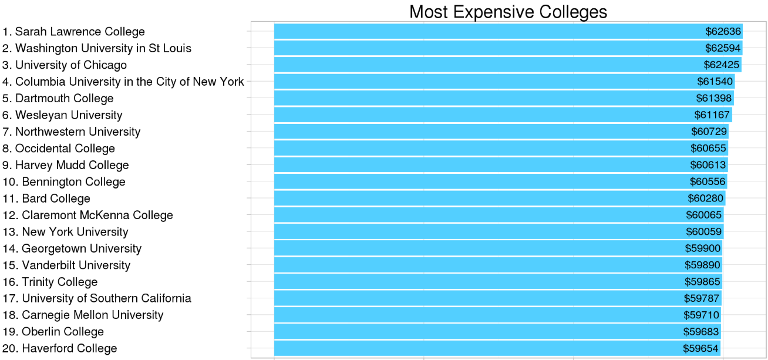
Statistical Analysis of the data

Slide 10
Overall model structure & workflow
Data
Data Preparation
Modeling
Deployment
Evaluation

Slide 11
Tools & Platforms
Azkaban
My SQL Database
Sqoop
Hadoop ( HDFS )
PySpark
Jupyter
Flask
GitHub repository

Slide 12
Data Exploration and Preparation
Correlation
Null values detection
Outliers detection
Handling data encrypted or masked due to privacy issue
Handling Null/Nan values (Imputation with Mean / Median)
Categorical variables encoding (One-Hot Encoder)

Slide 13
Modeling
 | MSE Values |  | r2 score Values
 | Training Set | Tet Set | Training Set | Tet Set
XGBoost | 0.0053 | 0.0075 | 0.8629 | 0.8045
Ridge | 0.0100 | 0.0098 | 0.7428 | 0.7513
Lasso | 0.0101 | 0.0097 | 0.7401 | 0.7527
MLR | 0.0100 | 0.0097 | 0.7425 | 0.7525
SVR (Linear) | 0.0354 | 0.0355 | 0.0883 | 0.0985
SVR (RBF) | 0.0079 | 0.0394 | 0.7950 | -0.0004

Slide 14
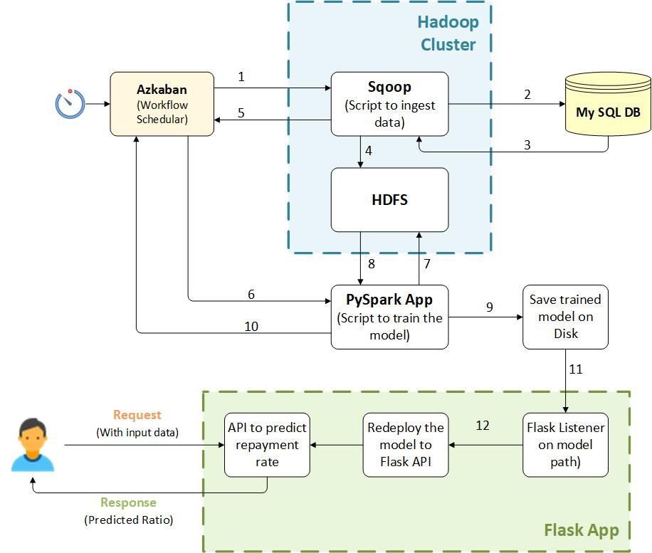
Deployment Workflow

Slide 15
References
https://collegescorecard.ed.gov/data/
https://www.kaggle.com/kaggle/college-scorecard
https://github.com/benhamner/us-college-scorecard
https://www.kaggle.com/apollostar/which-college-is-best-for-you/report
https://www.kaggle.com/apollostar/which-college-is-best-for-you-part2/report
https://rpubs.com/random_Island/education-loan-repayment
https://www.americanprogress.org/issues/education-postsecondary/reports/2016/12/19/295187/sharing-the-risk/

